Slide 1

My College Match

Slide 2
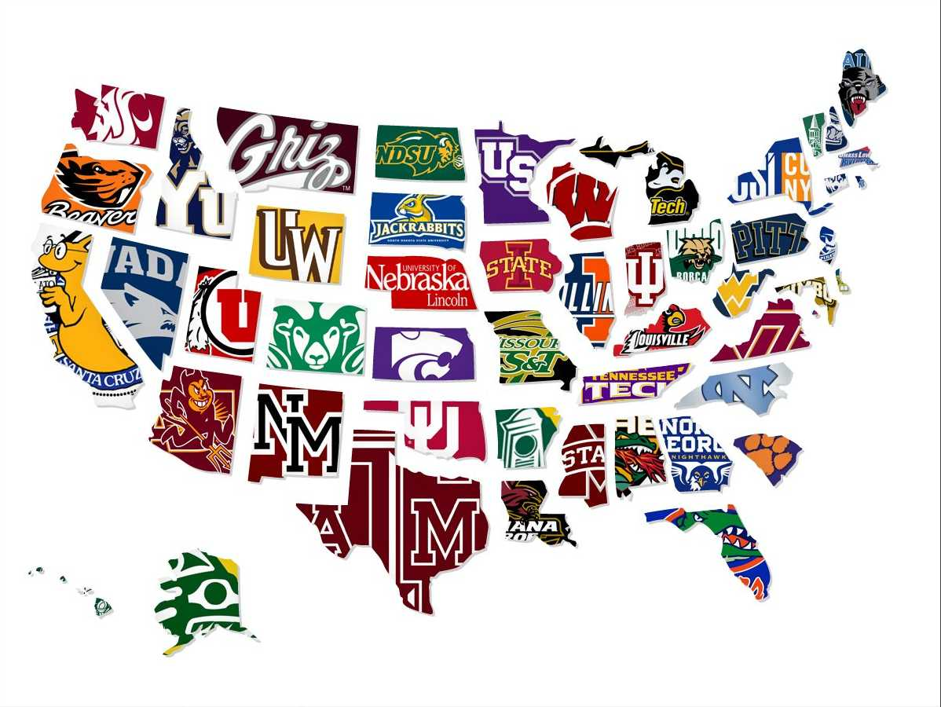
What College Is Right For Me?

Slide 3
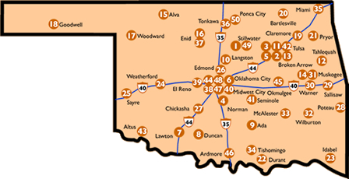
Oklahoma
Colleges and Universities

Slide 4
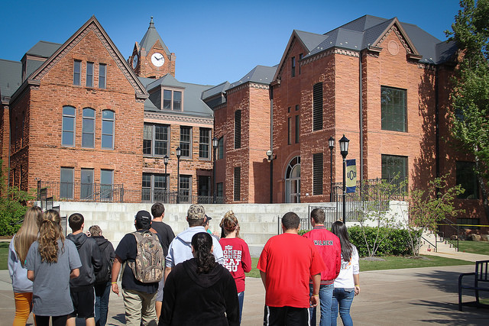
Things to Consider
Location
Cost
Size
Major
Type

Slide 5
Wrong Reasons
I’m a huge Fan
Student Body Looks & Parties
Rebel
Running Away
Legacy
Reputation
Following Friends

Slide 6
Things to Consider
Location
Cost
Size
Major
Type
Graduation Rate
Support Services
Demographics
Career Services
Extracurricular Activities

Slide 7
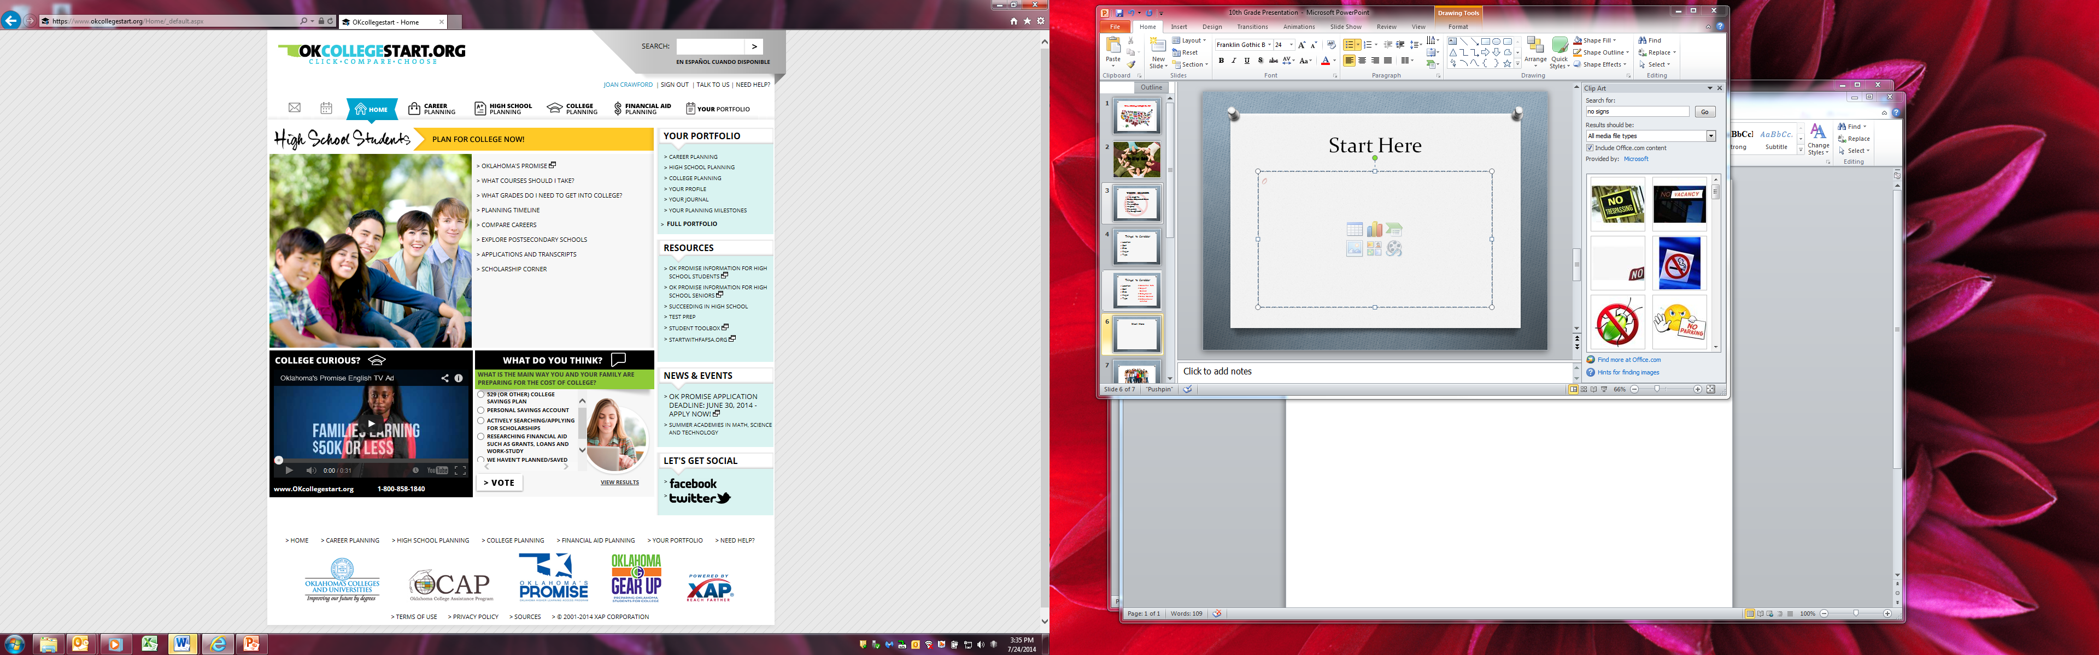
okcollegestart.org

Slide 8
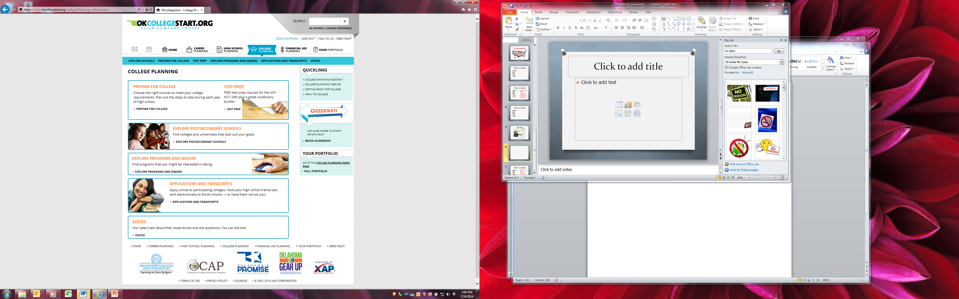
College Match

Slide 9
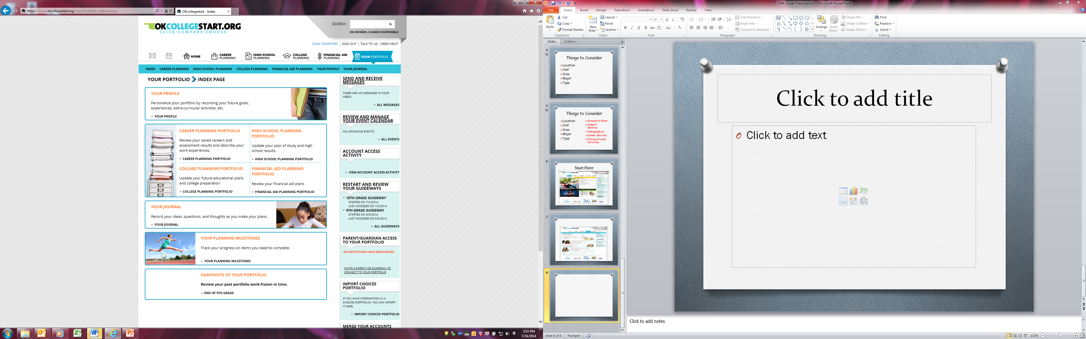
My Portfolio

Slide 10
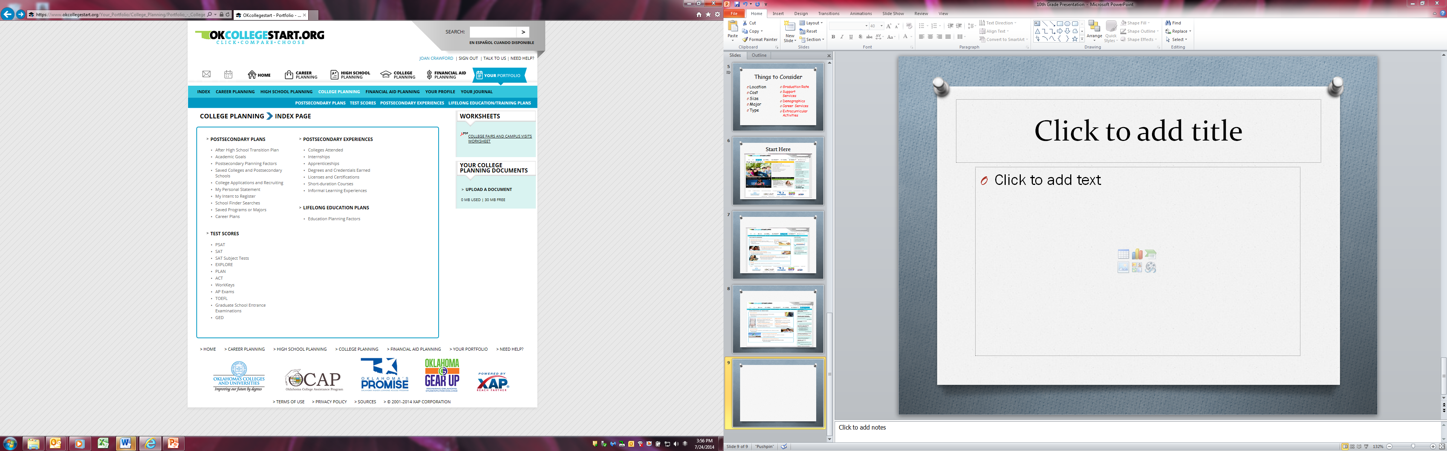
My Portfolio

Slide 11
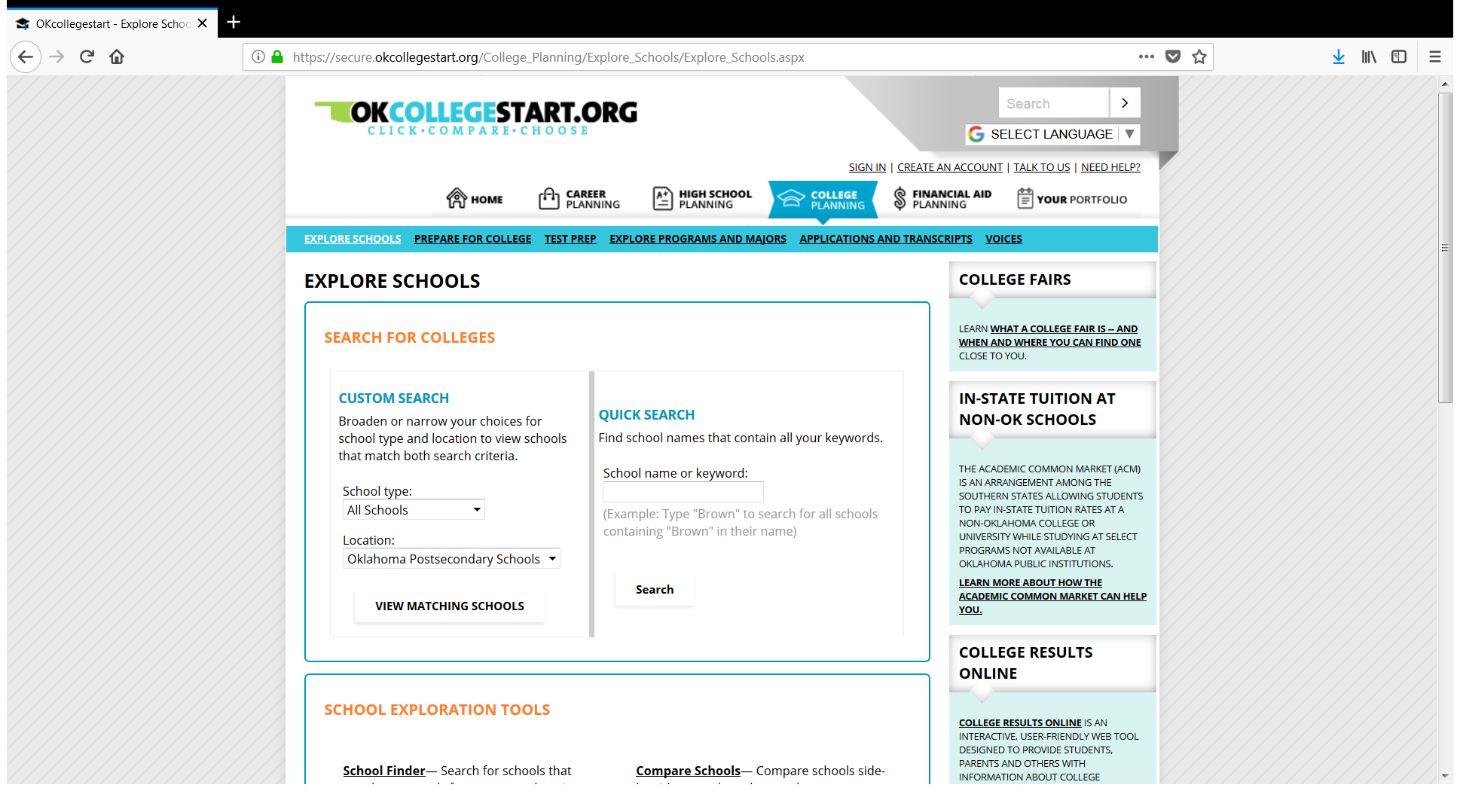
Explore Colleges

Slide 12
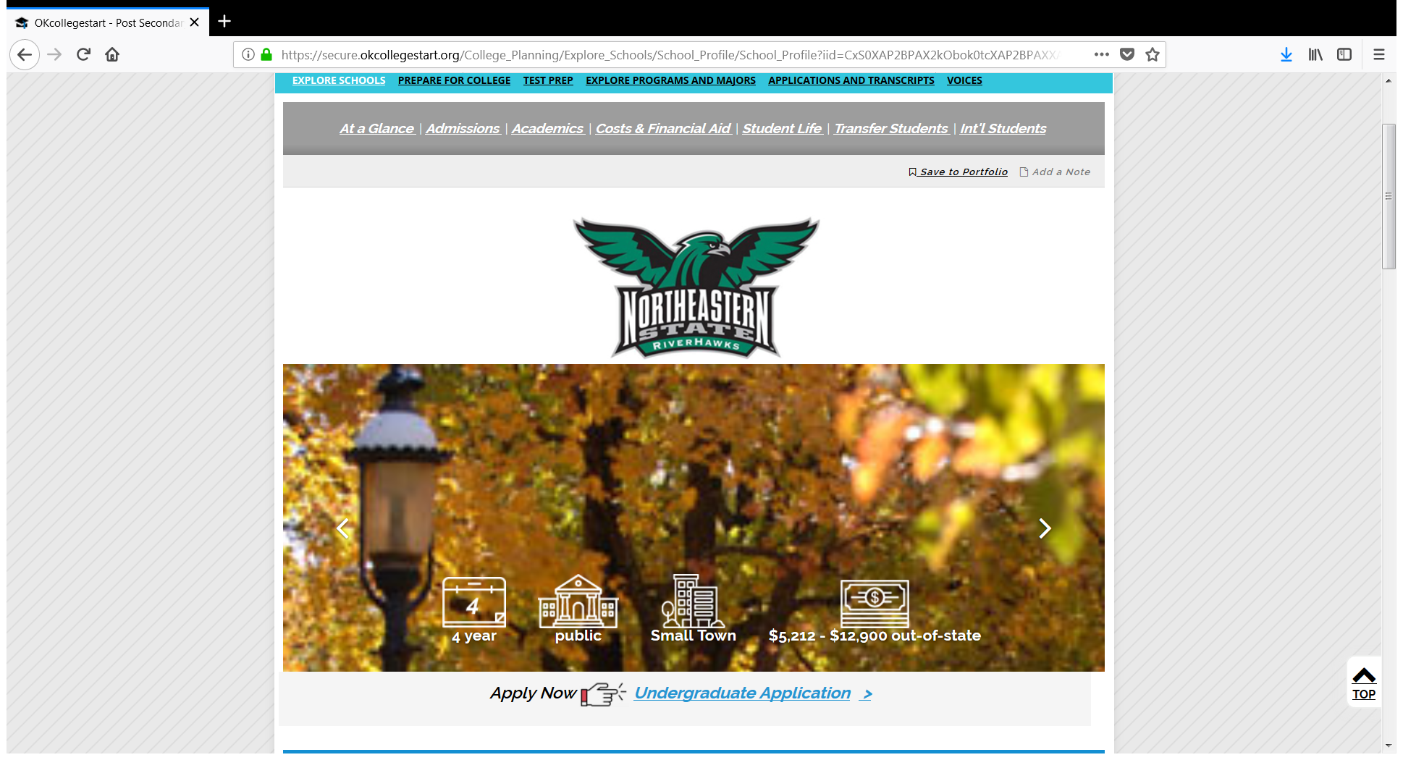
See Detailed College Profiles

Slide 13
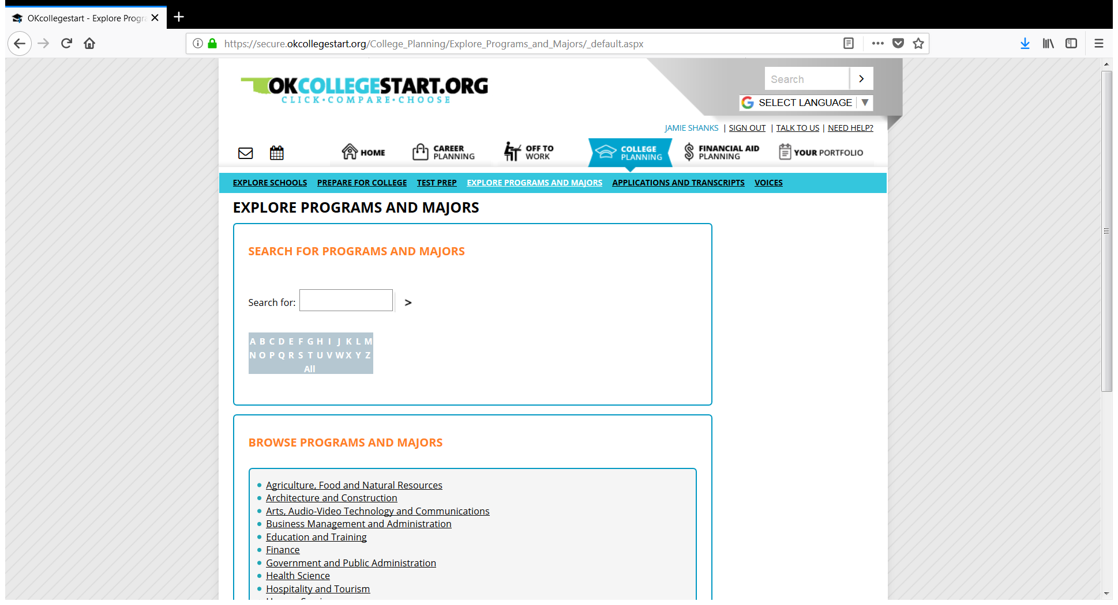
Explore Programs & Majors

Slide 14
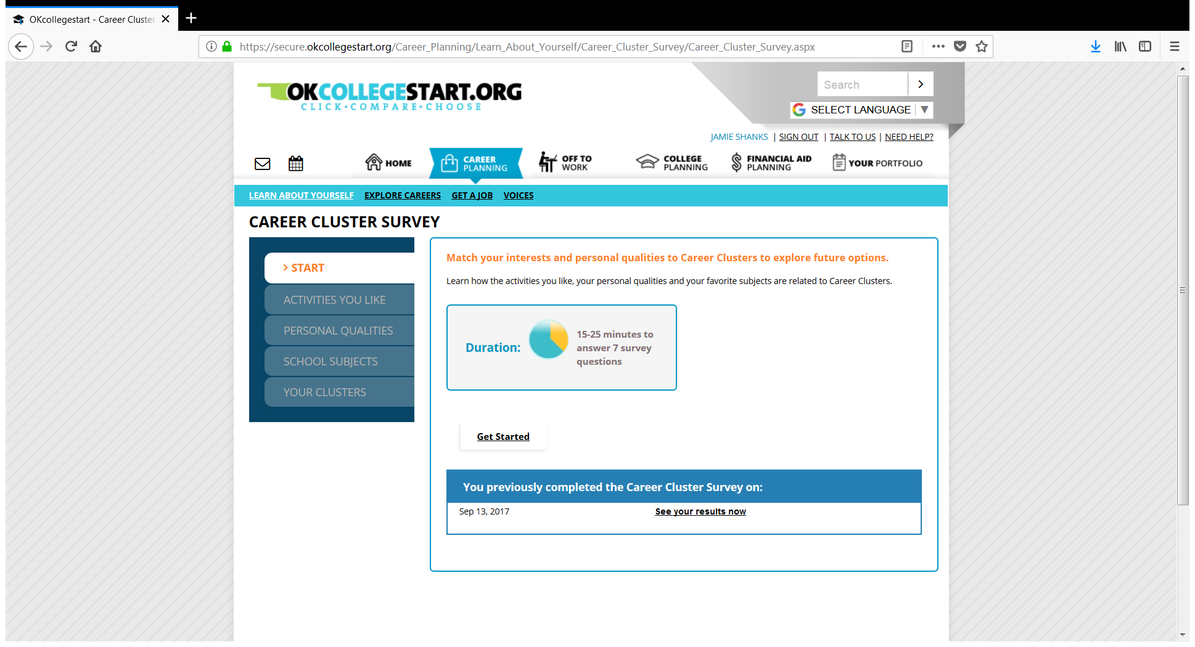
Take the Career Cluster Survey!

Slide 15
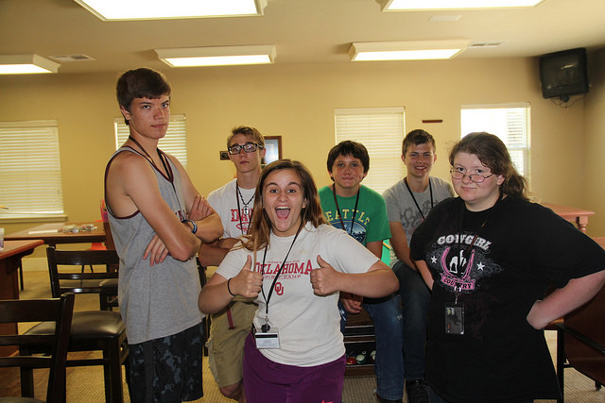
College Bound!

Slide 16

Questions

