Slide 1
Oklahoma Higher Learning Access Program
2024-25

Slide 2
Apply Online at
www.okpromise.org

Slide 3
Application Requirements
Student must currently be attending the 8th, 9th, 10th or 11th grade
Income limit at the time of application
$60K with 1-2 dependent children
$70K with 3-4 dependent children
$80K with 5 or more dependent children
(there is a check for a 2nd income limit when the student starts college or career education)
Must be an Oklahoma resident
Deadline for the 2024-2025 school year:
June 30, 2025
Notes:
We will continue to work on the definition of dependent children
Work off of the tax return
Biological child, step child, foster child, adopted child
Will not apply to dependent parents, grandparents, aunts/uncles, nieces or nephews
Does NOT apply to the 2021-22 school year, however if someone applied previously and were denied due to being over income, they could apply again IF the student is in a qualifying grade level and their income now qualifies.

Slide 4
Application and Income
What income is counted?
Whose income should be provided?
Income limit - $60K-$80K or $100K – Which is correct?
Special income provisions: Foster care, Legal Guardianship, Children adopted from certain court-ordered custody
For answers to these and other questions, check the OKPromise FAQ on the website at www.okpromise.org.

Slide 5
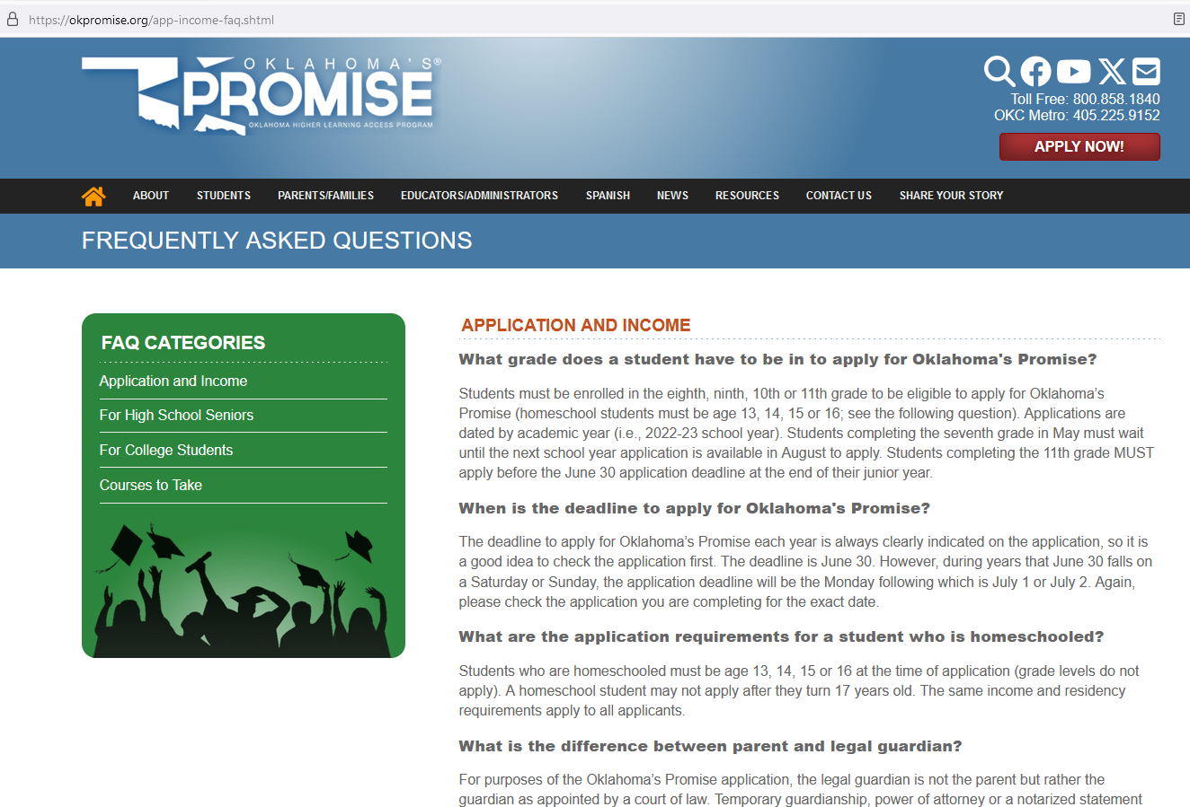
Notes:
This is an example of what the Application and Income FAQ looks like.

Slide 6
December 31 Incomplete App deadline
June 30 remains the deadline for the initial application.
Applications are incomplete until the income documentation is received and processed.
December 31 of the student’s senior year (prior to graduation) is the deadline for the income documentation of the incomplete application.
Notes:
Note to Counselors: As many of you know, we have a number of applications that remain incomplete until very late into their senior year. Unbeknownst to you, they might complete it on the last day of school. Unfortunately, then they are calling you in the middle of the summer trying to get you to complete the final paperwork. In an effort to expedite this process, a second deadline was implemented which is December 31 of the student’s senior year or Dec 31 prior to the student’s HS graduation. This should help alleviate some of the craziness that occurs at the end of the school year with incomplete applications and should help students/counselors to verify if they are enrolled in the correct courses.

Slide 7
Curriculum – 15 units
4 English
3 Lab Science
3 Mathematics
3 History and Citizenship Skills
2 Additional Units of subjects previously listed or selected from: computer science, foreign language, any Advanced Placement course, psychology, sociology, or any concurrent liberal arts and science course at a State System institution
Notes:
Think carefully about the concurrent courses that you are taking. You want to be sure that it will apply to your general education requirements or your intended major in college.

Slide 8
Additional Requirements
Graduate from an Oklahoma high school
Complete the 15-unit curriculum with at least a 2.50 cumulative GPA in these courses
Achieve at least a 2.50 cumulative overall GPA
Attend school regularly
Refrain from substance abuse
Don’t commit criminal or delinquent acts
Notes:
EMPHASIZE THIS!!
Complete the 17 unit curriculum with at least a 2.50 cumulative GPA in these units

Slide 9
Benefits
Pays tuition only (fees are not included) at an Oklahoma public college or university; a portion of tuition at an Oklahoma private college or university or qualified career technology programs
OKPromise cannot pay for concurrent enrollment
May be used until the completion of a bachelor’s degree or five consecutive years, whichever comes first
The OKP award is also limited to payment for 129 credit hours of college courses (unless the degree program requires more hours).
Notes:
There are two tracks for a student choosing to attend an Oklahoma public career technology center:
For students completing the OKPromise/college admission 15-unit curriculum, the scholarship will cover at least a portion of tuition for certain programs that meet the requirements to be eligible for federal financial aid offered at an Oklahoma public technology center. The scholarship will transfer to a college or university if the student chooses to pursue that track for their education.
For students completing the CORE high school graduation requirements, the scholarship will cover at least a portion of tuition for certain programs that meet the requirements to be eligible for federal financial aid offered at an Oklahoma public technology center. The scholarship is only available to be used at career technology centers and is not transferable to a college or university.

Slide 10
Career Tech options
At an Oklahoma public technology center, the scholarship will cover at least a portion of tuition for certain programs that meet the requirements to be eligible for federal financial aid.
For students completing the OKPromise college admission 15-unit curriculum, the scholarship will transfer to a college or university.
OR
For students completing the CORE high school graduation requirements, the scholarship is only available to be used at career technology centers and is not transferable to a college or university.

Slide 11
College Requirements
Students must file the FAFSA each year in college or career education
To receive the award, the federal adjusted gross income (AGI) of the student’s parents may not exceed $100,000
Any OKPromise student on financial aid suspension for failure to meet SAP (Satisfactory Academic Progress), will not be eligible to receive the OKPromise award

Slide 12
Contact Information OKPromise office
1.800.858.1840 (option 2)
OR
okpromise@osrhe.edu

