Slide 1
2024-25

Slide 2
Application Requirements
Student must currently be attending the 8th, 9th, 10th or 11th grade
Income limit at the time of application
$60K with 1-2 dependent children
$70K with 3-4 dependent children
$80K with 5 or more dependent children
(there is a check for a 2nd income limit when the student starts college or career education)
Must be an Oklahoma resident
Deadline for the 2024-2025 school year:
June 30, 2025
Notes:
We will continue to work on the definition of dependent children
Work off of the tax return
Biological child, step child, foster child, adopted child
Will not apply to dependent parents, grandparents, aunts/uncles, nieces or nephews
Does NOT apply to the 2021-22 school year, however if someone applied previously and were denied due to being over income, they could apply again IF the student is in a qualifying grade level and their income now qualifies.

Slide 3
Classes to take – 15 units
4 English
3 Lab Science
3 Mathematics
3 History and Citizenship Skills
2 Additional Units of subjects previously listed or selected from: computer science, foreign language, any Advanced Placement course, psychology, sociology, or any concurrent liberal arts and science course at a State System institution
Notes:
Think carefully about the concurrent courses that you are taking. You want to be sure that it will apply to your general education requirements or your intended major in college.

Slide 4
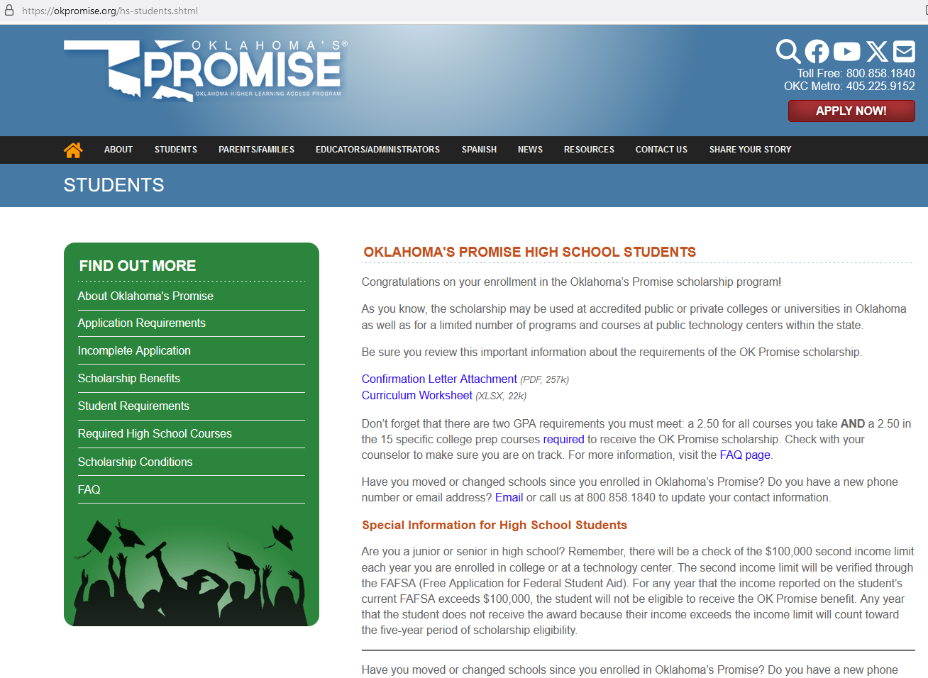
Notes:
This page from the OKPromise website is located under Students (on the drop down menu) then High School. Point out the blue link to the Curriculum Worksheet which will help them track their courses. There is also a link where they can Email the OKPromise office if they have a change to their contact information. When you click on the FAQ (at the bottom of the green box), you will get the screen shown on the next page.

Slide 5
Additional Requirements
Graduate from an Oklahoma high school
Complete the 15-unit curriculum with at least a 2.50 cumulative GPA in these courses
Achieve at least a 2.50 cumulative overall GPA
Attend school regularly
Refrain from substance abuse
Don’t commit criminal or delinquent acts
Notes:
EMPHASIZE THIS!!
Complete the 17 unit curriculum with at least a 2.50 cumulative GPA in these units

Slide 6
Benefits
Pays tuition only (fees are not included) at an Oklahoma public college or university; a portion of tuition at an Oklahoma private college or university or qualified career technology programs
OKPromise cannot pay for concurrent enrollment
May be used until the completion of a bachelor’s degree or five consecutive years, whichever comes first
The OKP award is also limited to payment for 129 credit hours of college courses (unless the degree program requires more hours).
Notes:
There are two tracks for a student choosing to attend an Oklahoma public career technology center:
For students completing the OKPromise/college admission 15-unit curriculum, the scholarship will cover at least a portion of tuition for certain programs that meet the requirements to be eligible for federal financial aid offered at an Oklahoma public technology center. The scholarship will transfer to a college or university if the student chooses to pursue that track for their education.
For students completing the CORE high school graduation requirements, the scholarship will cover at least a portion of tuition for certain programs that meet the requirements to be eligible for federal financial aid offered at an Oklahoma public technology center. The scholarship is only available to be used at career technology centers and is not transferable to a college or university.

Slide 7
Career Tech options
At an Oklahoma public technology center, the scholarship will cover at least a portion of tuition for certain programs that meet the requirements to be eligible for federal financial aid.
For students completing the OKPromise college admission 15-unit curriculum, the scholarship will transfer to a college or university.
OR
For students completing the CORE high school graduation requirements, the scholarship is only available to be used at career technology centers and is not transferable to a college or university.

Slide 8
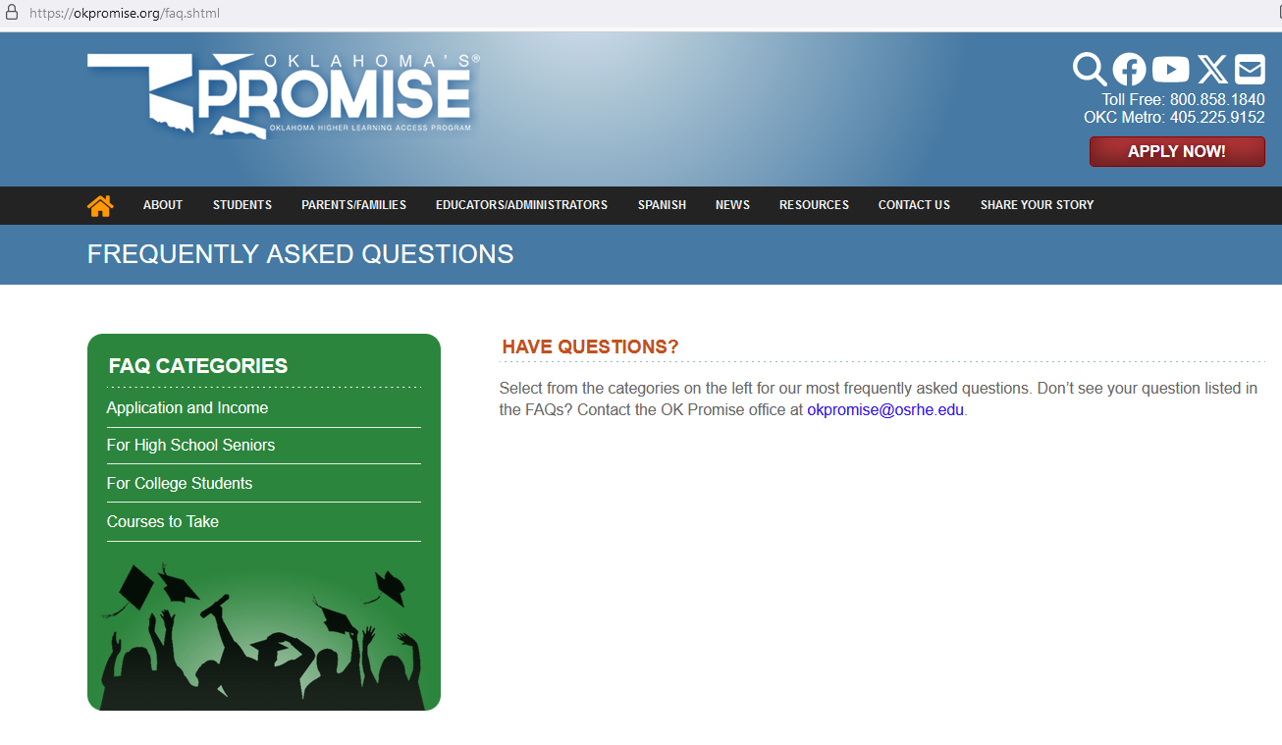
Notes:
The Application and Income FAQ is very helpful to parents and students filling out the OKPromise application. The Courses to Take will help enrolled students plan their schedules by showing them accepted courses. The link For High School Seniors will help enrolled students understand the process during their senior year and the summer before college. For College Students will help them to understand how the scholarship can be used after they graduate.

Slide 9
OKPromise Enrolled Seniors
www.okpromise.org – FAQ for HS Seniors and FAQ for College Students
Two GPAs – overall and core OKP
Contact OKP with address updates
HS submits the final paperwork to the OKPromise office after final transcripts are available
Students will be notified during the summer (likely late June/July)

Slide 10
Seniors (cont.)
File the 2025-26 FAFSA
Watch your bursar account at the school. Don’t panic early in the semester but don’t wait until the end of the semester to check on the status.
Communicate with the financial aid office!

Slide 11
Contact Information OKPromise office
1.800.858.1840 (option 2)
OR
okpromise@osrhe.edu

