Slide 1

2026–27 FAFSA® Preview Presentation
Remember to do the 2026-27 FAFSA
You will be using 2024 tax information.
The 2026–27 version of the FAFSA is Available now!
The 2026–27 FAFSA form includes a new process to invite FAFSA contributors to the form.

Slide 2
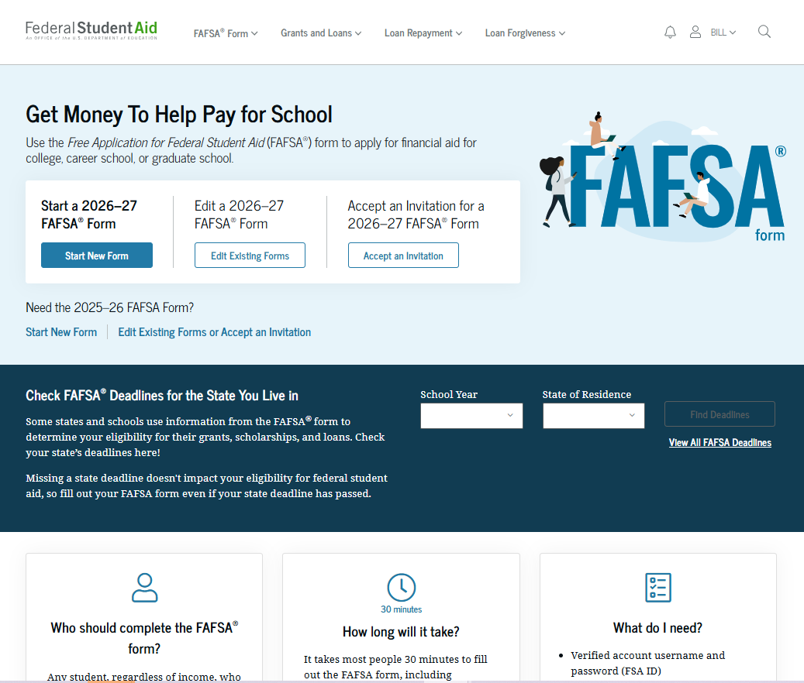

Dependent Student: FAFSA® Landing Page
This is the main FAFSA® landing page. On this page, students are directed to "Start New Form," "Edit Existing Forms," or "Accept an Invitation." For this section of the presentation, the student is beginning a new application.

Slide 3
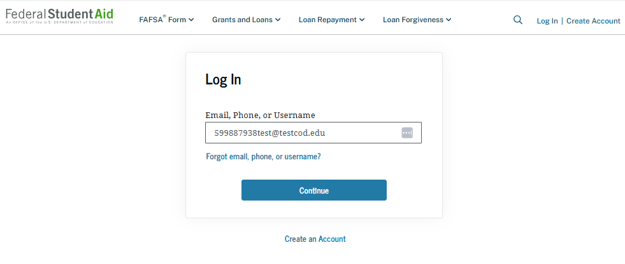
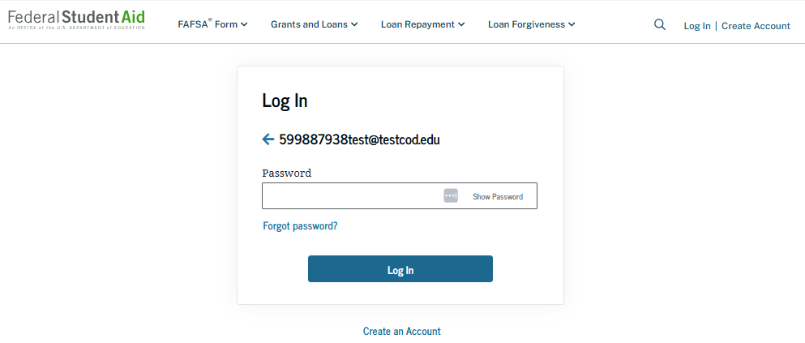
Dependent Student: Log-in
If the student selects "Start New Form" from the FAFSA® landing page and they are not logged in to StudentAid.gov, the student is taken to the "Log In" page to enter their credentials. To access the FAFSA form, all students are required to have a StudentAid.gov account username and password. If the student doesn't have a username and password, they can select "Create an Account.“ Students will need to know their SSN!

Slide 4
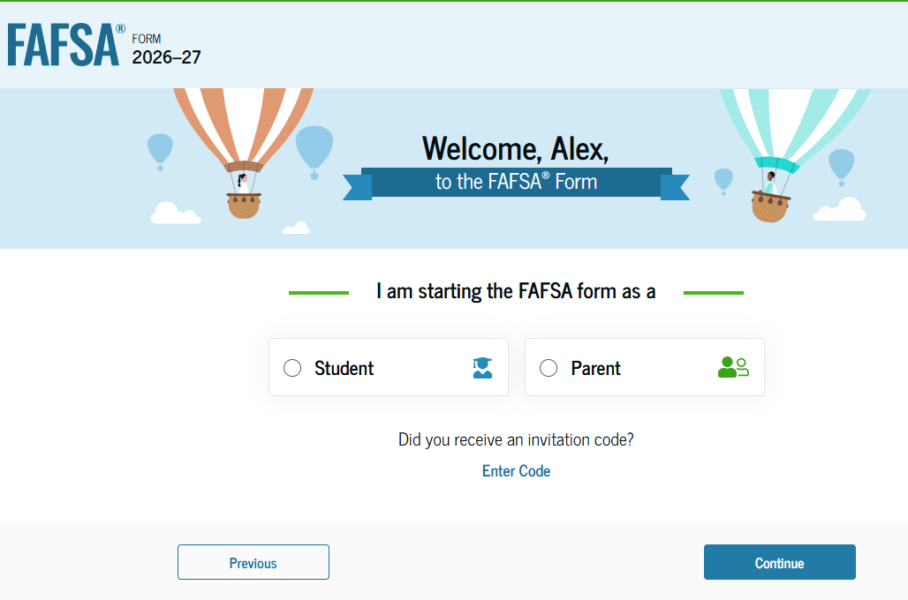
Dependent Student: Roles
After logging in, the student can select “Student.”
There are four onboarding screens with LOTS of information if you need help!

Slide 5
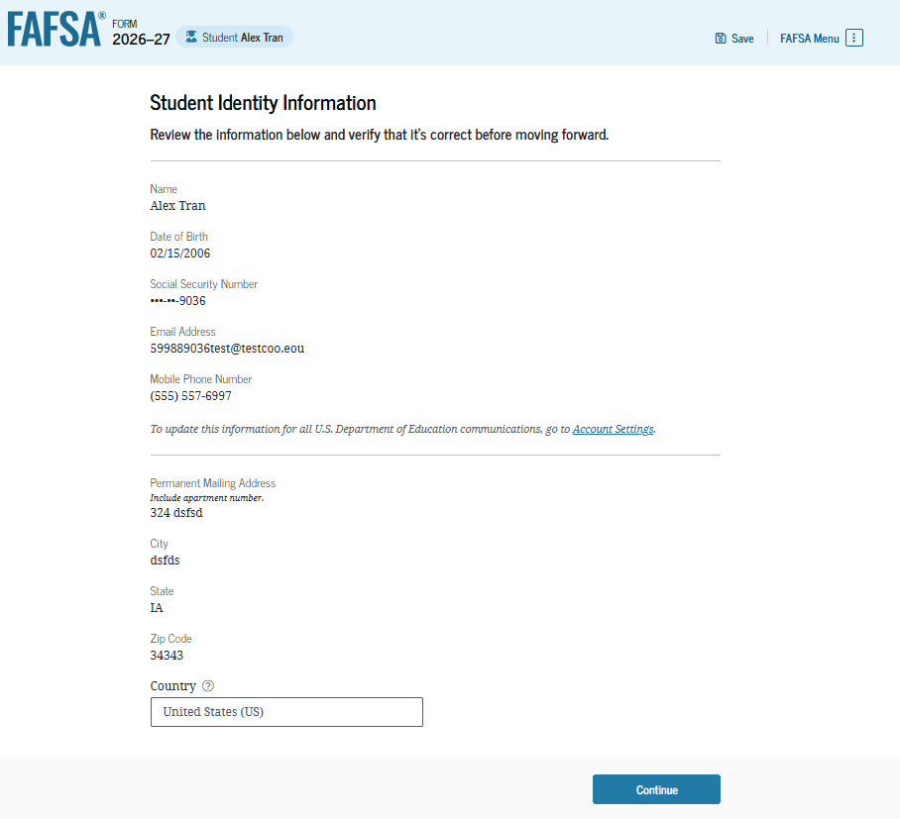
Dependent Student: Student Identity Information
This is the first page within the student section. The student can verify that the personal information is correct. To update any of the personal information, the student must access their account settings on StudentAid.gov.

Slide 6
Student ID inf0
Consent and Approval
State of Residence
How long?
These are the screens that students will work through.
Personal Circumstances:
Marital Status
College/Career plans
Unusual Circumstances
Homelessness
Student Demographics
Student Financials
Select Colleges & Career Techs
Students can select up to 20 institutions.

Slide 7
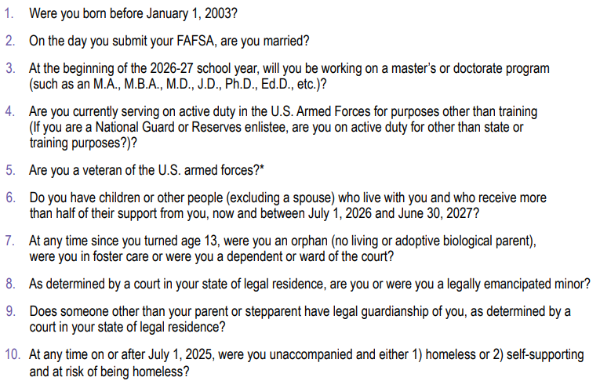
Dependent Student Status
If a student answers yes to any of these questions, they are a dependent student and will NOT need to provide parent/contributor information.
Notes:
For the sake of this presentation, we are moving forward with discussing the DEPENDENT student and the parent contributor. If you know of a student who might be considered independent, please have them contact their counselor or GEAR UP Site Director for assistance.

Slide 8
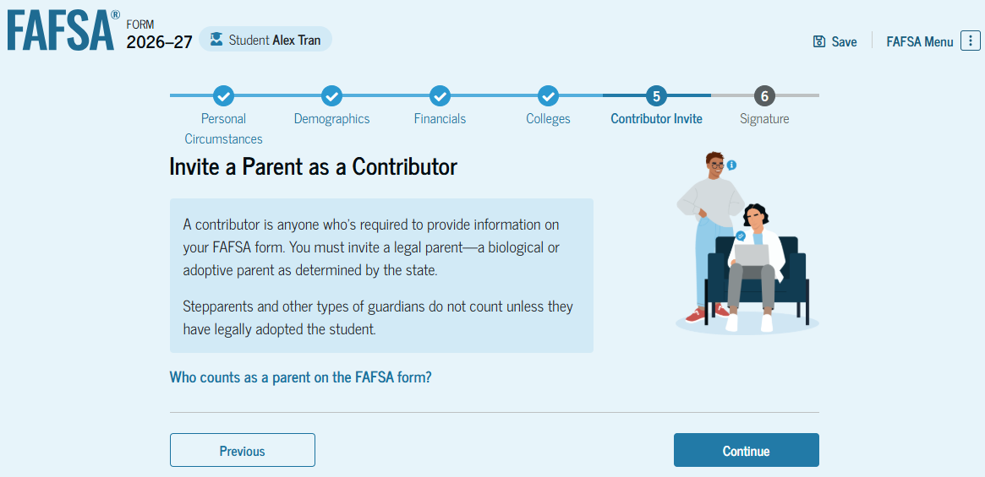
Introduction: Dependent Student Invites Contributor
This is the first page in the "Invite a Parent as a Contributor" section, which is the last student section to require information. It provides an overview of the section.

Slide 9
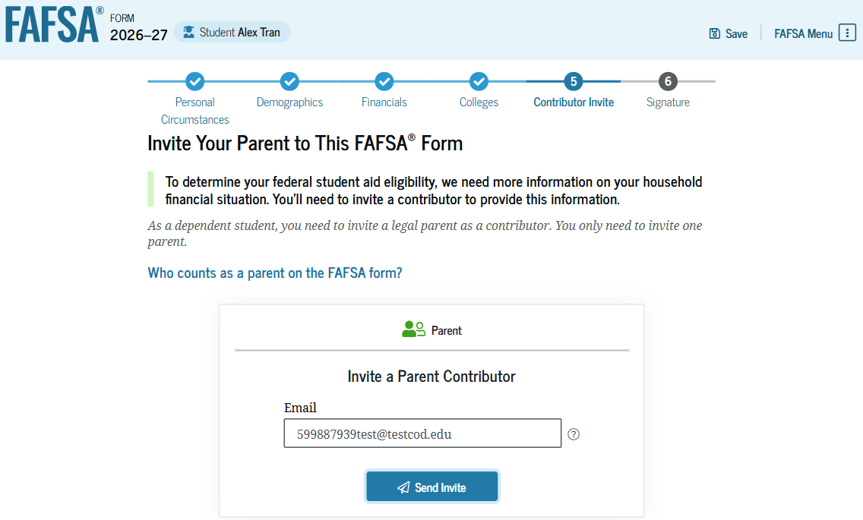
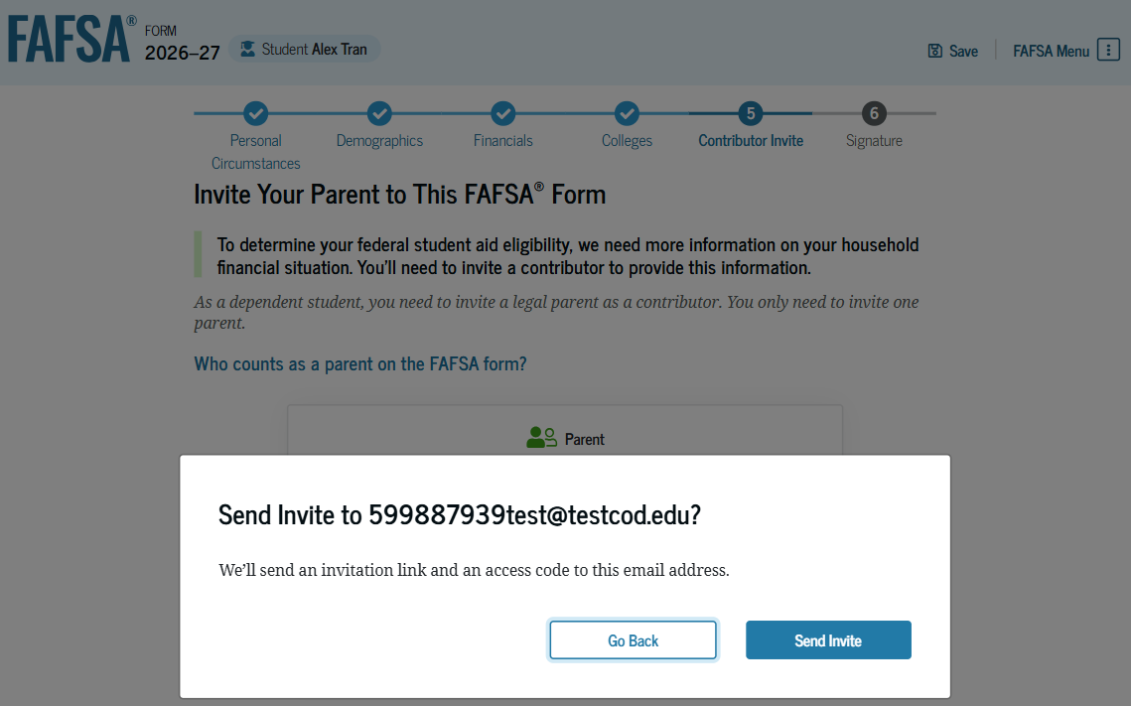
Dependent Student: Invite Contributor (Continued 1 of 2)
The student is asked to enter their parent’s email address to invite the parent to the FAFSA® form. After entering the email address, the student selects "Send Invite." A pop-up window appears, and the student confirms their parent’s email address by selecting "Send Invite."

Slide 10
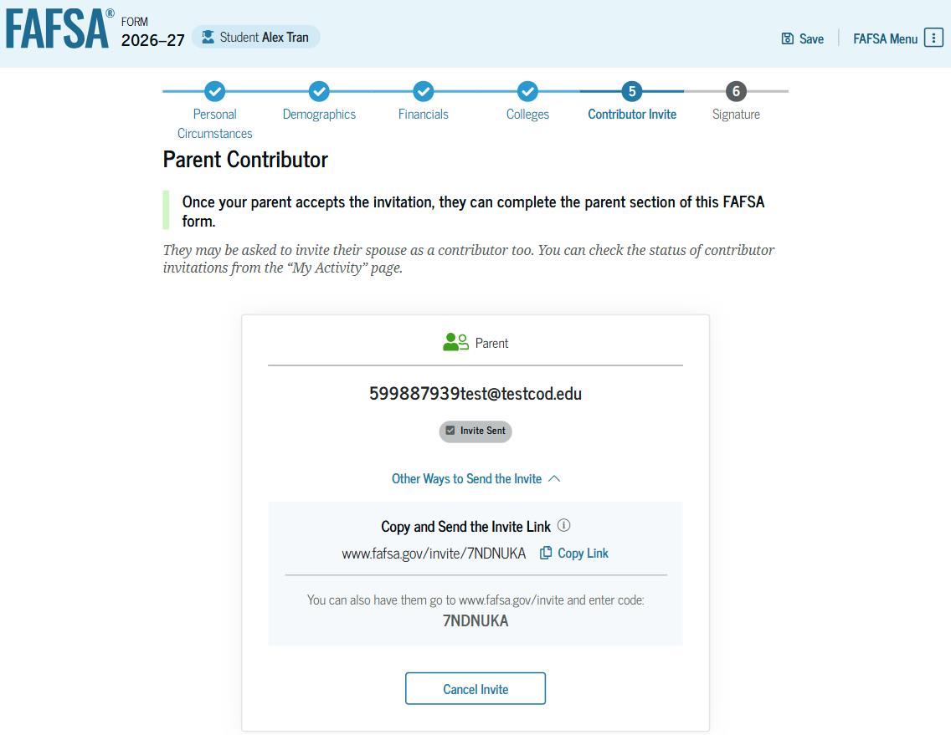
Dependent Student: Invite Contributor (Continued 2 of 2)
This page confirms the student’s parent will receive an email inviting them to the student’s FAFSA® form. The parent can access the form by accepting the invitation in the email. On this page, the student is also provided an invitation link and invitation code that can be shared directly with the parent.

Slide 11
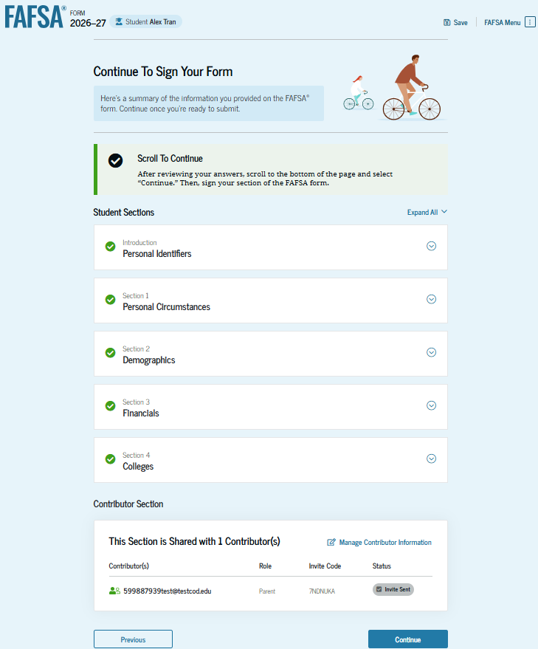
Dependent Student: Review Page
The review page displays the responses that the student has provided in the FAFSA® form. The student can view all responses by selecting "Expand All" or expand each section individually. To edit a response, the student can select the question’s hyperlink to be taken to the corresponding page.

Slide 12
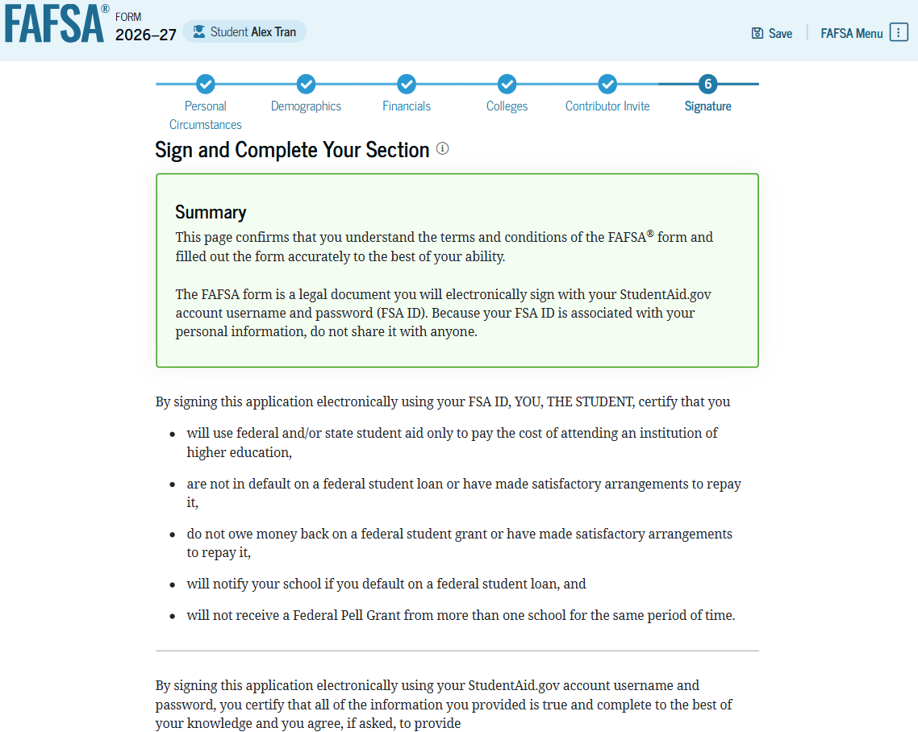
Dependent Student: Signature
On this page, the student reviews the terms and conditions of the FAFSA® form and what they’ll agree to when the student signs the form.
Don’t skip this step!

Slide 13
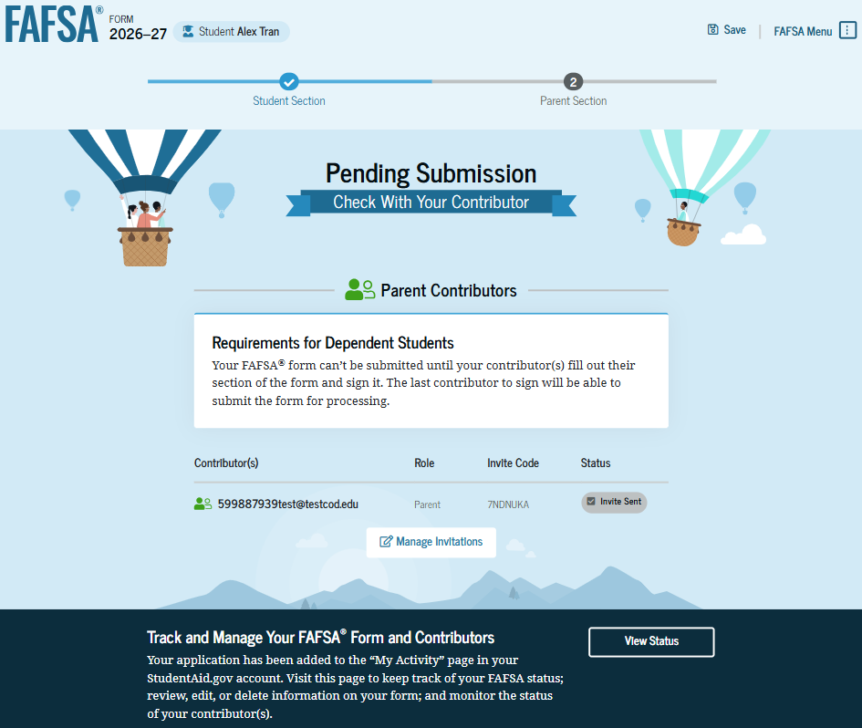
Dependent Student: Section Complete
Upon digitally signing the student section, the student is presented with the "Pending Submission" page. The student is reminded that their FAFSA® form is not completed and can’t be submitted until the parent completes the contributor section of the form and signs it. This page also displays next steps the student can take, including tracking and managing their form.

Slide 14
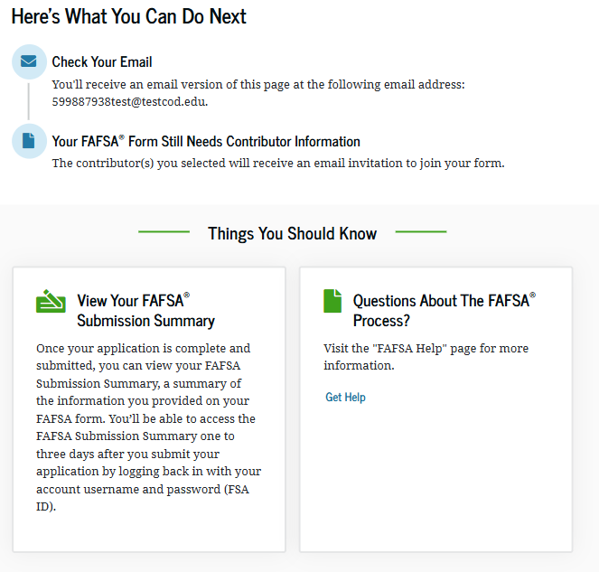

Dependent Student: Section Complete (Continued)
This is a continuation of the student section complete page. This page displays information for the student about next steps, including checking their email and a reminder that their FAFSA® form is not completed and can’t be submitted until the parent completes the contributor section of the form and signs it. Next, in this scenario, the invited parent will enter the FAFSA form and complete the parent section.

Slide 15
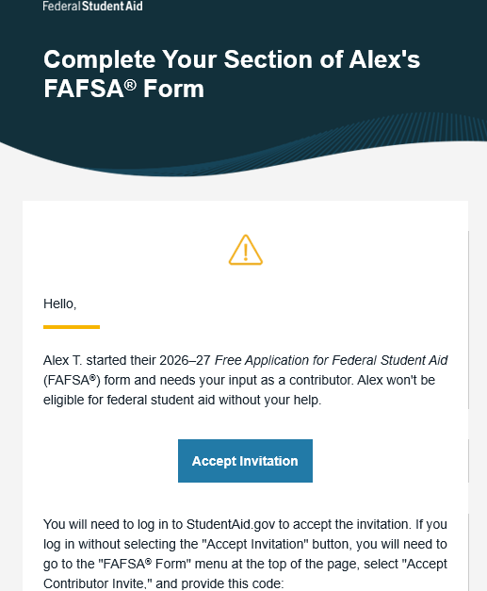
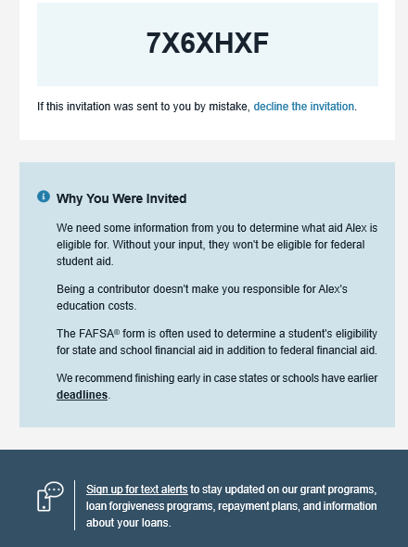
Dependent Student: Parent Email
This is an example of what the parent invitation email looks like.
The parent selects "Accept Invitation" and is taken to StudentAid.gov.

Slide 16
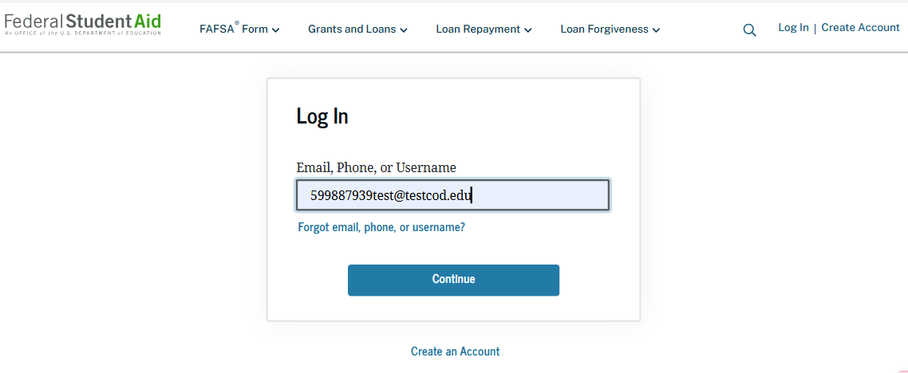
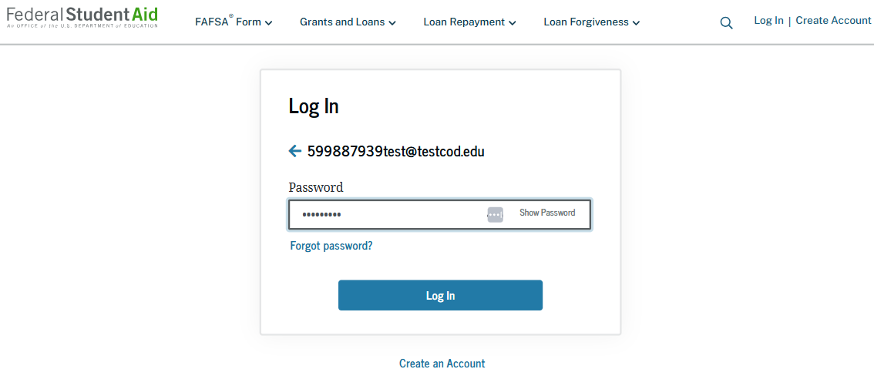
Dependent Student: Parent Log-in
The parent is taken from their email to the "Log In" page to enter their credentials. To access the FAFSA® form, all users are required to have a StudentAid.gov account username and password. If the parent doesn't have a username and password, they can select "Create an Account."

Slide 17
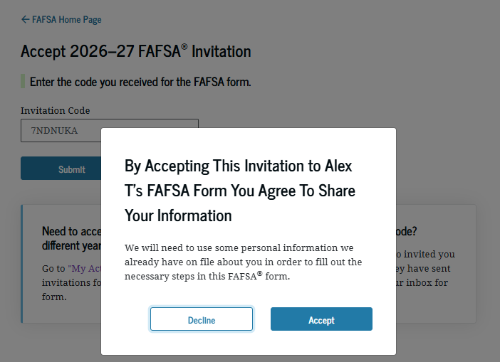
Dependent Student: Parent Accepts Invitation (Continued)
When the parent selects "Submit," a pop-up window appears, confirming the student’s name and reminding the parent that their personal information is needed to fill out the student’s FAFSA® form. The parent selects "Accept" to agree to sharing their information and enters the FAFSA form.

Slide 18
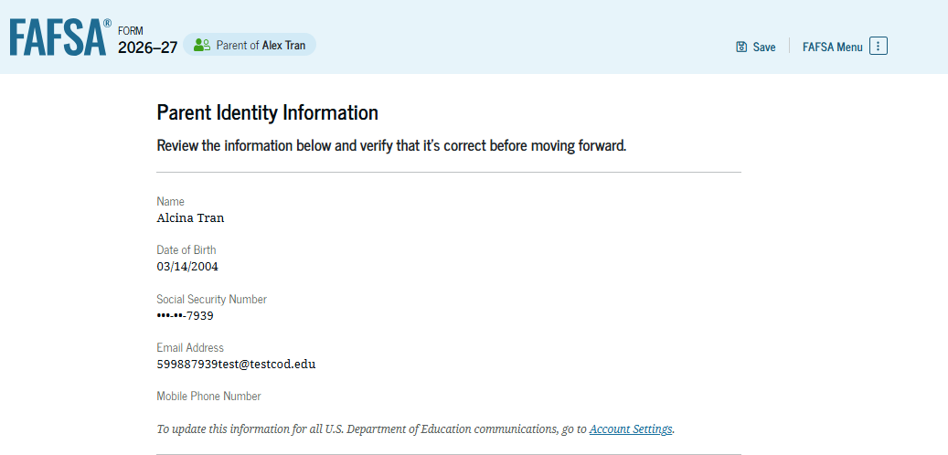
Dependent Student: Parent Identity Information
This is the first page within the parent section. The parent can verify that the personal information is correct. To update any of the personal information, the parent must access their account settings on StudentAid.gov.

Slide 19
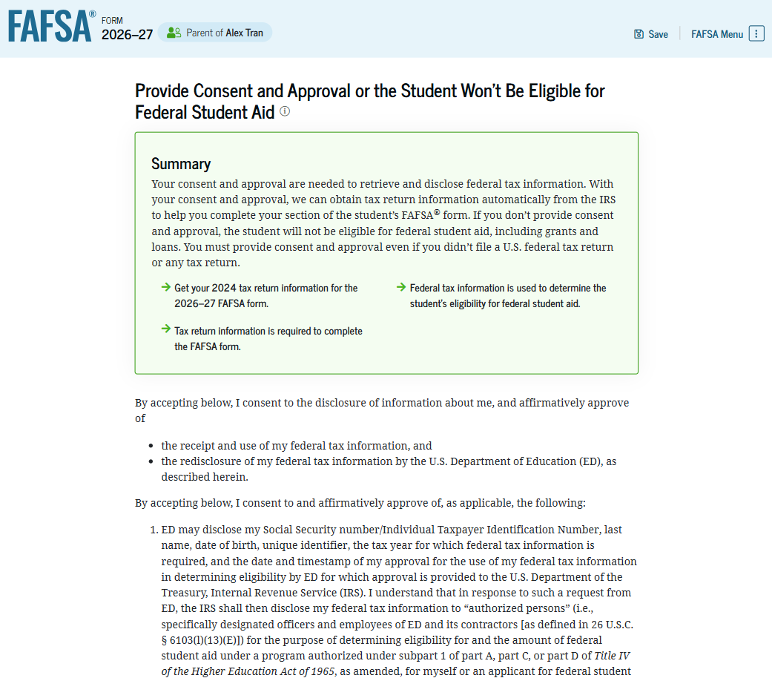
Dependent Student: Parent Provides Consent and Approval
This page informs the parent about consent, approval, and the use of their federal tax information. Once the parent provides consent and approval, their federal tax information is transferred directly from the IRS into the FAFSA® form to help complete the "Parent Finances" section.

Slide 20
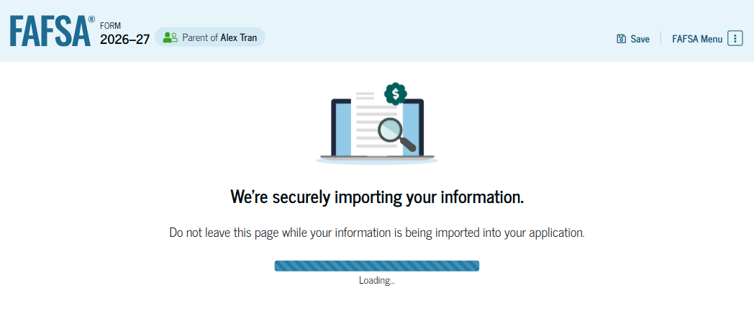
Dependent Student: Parent Imports IRS Information
This page imports the parent’s federal tax information by directly transferring it from the IRS into the FAFSA® form to help complete the "Parent Finances" section.
Always default and link with the IRS. Don’t manually enter your tax information unless you have to.

Slide 21
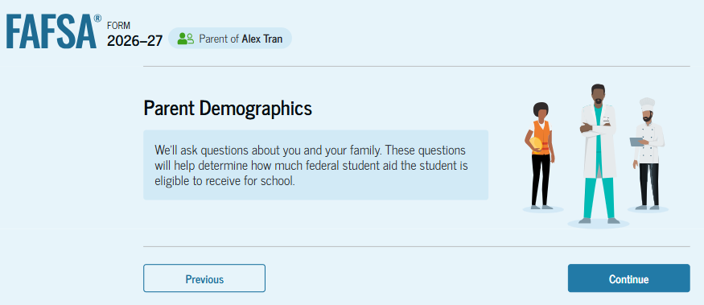
Introduction: Dependent Student’s Parent Demographics
This is the first page in the "Parent Demographics" section. It provides an overview of the section.

Slide 22
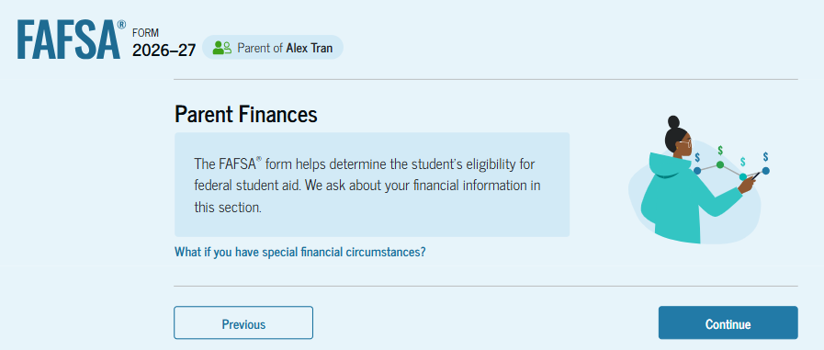
Introduction: Dependent Student’s Parent Finances
This is the first page within the "Parent Finances" section. It provides an overview of the section. The parent can select the hyperlink to learn about special financial circumstances.

Slide 23
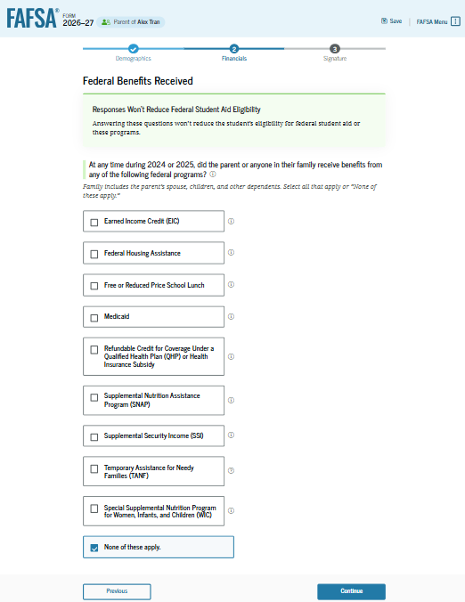
Dependent Student: Parent Federal Benefits Received
This page asks the parent if the parent or anyone in the parent’s family has received federal benefits. The parent selects "None of these apply” if applicable.

Slide 24
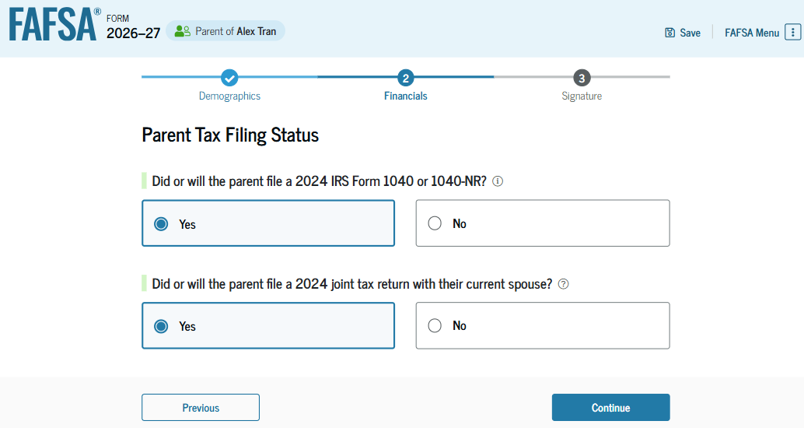
Dependent Student: Parent Tax Filing Status
This page asks the parent about their tax filing status. The parent selects "Yes" to "Did or will the parent file a 2024 IRS Form 1040 or 1040-NR?" and "Yes" to "Did or will the parent file a 2024 joint tax return with their current spouse?“
REMEMBER, THE FAFSA IS ASKING FOR YOU 2024 TAXES.

Slide 25
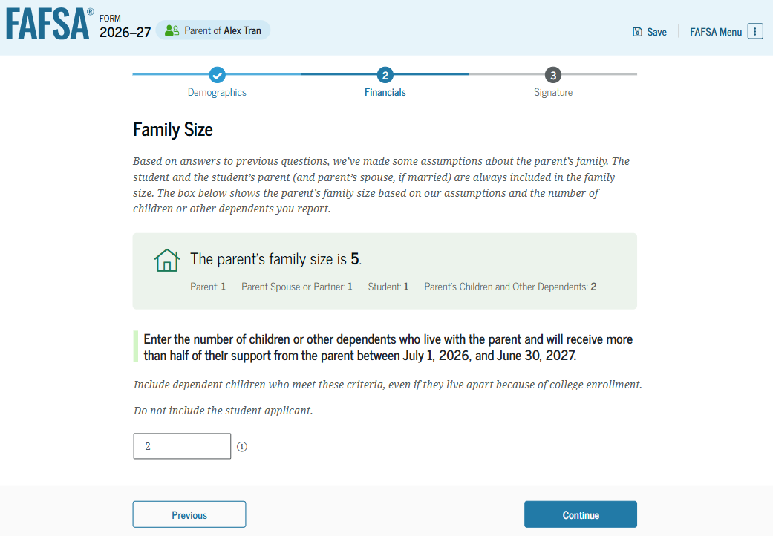
Dependent Student: Parent Family Size
This page displays the family size for the student. The parent has the option to enter the number of children or other dependents who live with the parent and will receive more than half of their support from the parent between July 1, 2026, and June 30, 2027.

Slide 26
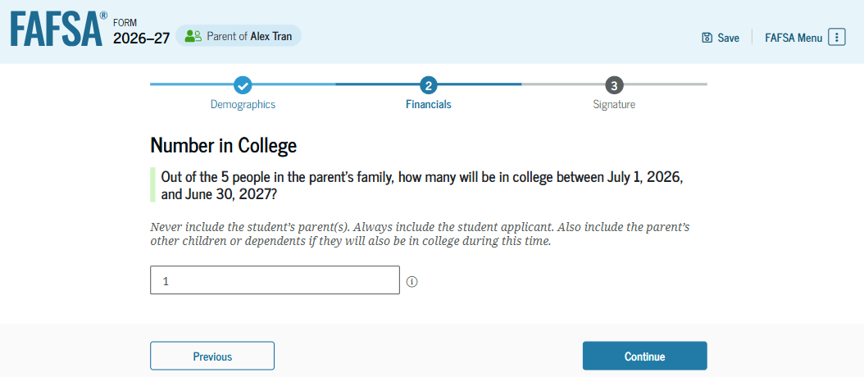
Dependent Student: Parent Number in College
This page asks the parent how many people in the family will be in college between July 1, 2026, and June 30, 2027. The parent enters a response into the entry field.

Slide 27
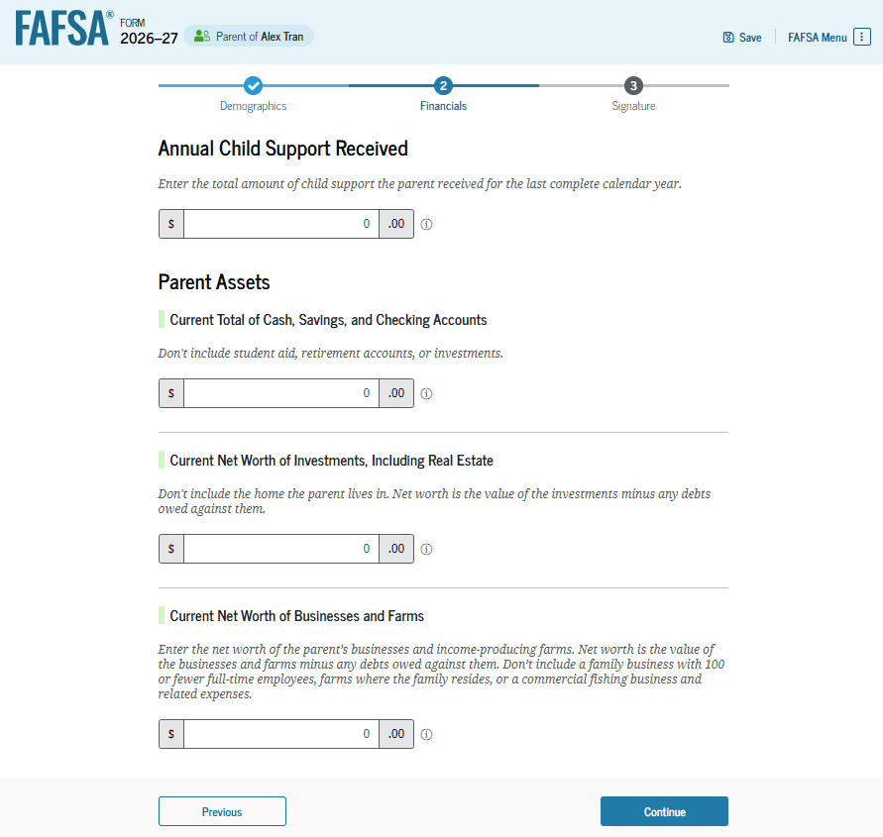
Dependent Student: Parent Assets
The parent is asked about their assets. The parent enters a response in each entry field. If the parent has nothing to report, the parent enters the numeral zero.

Slide 28
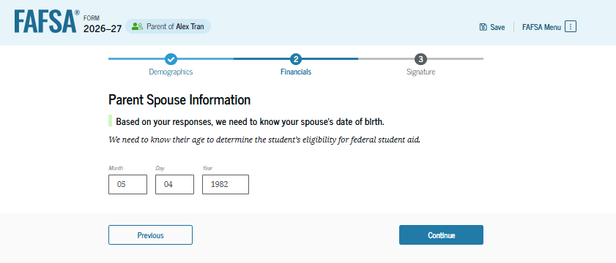
Dependent Student: Other Parent Information
The parent is asked to provide information about their spouse or partner. In this example, the other parent does not need to contribute to the student’s FAFSA® form because the parents filed taxes jointly. After providing the other parent’s date of birth, all required parent information will be complete.

Slide 29
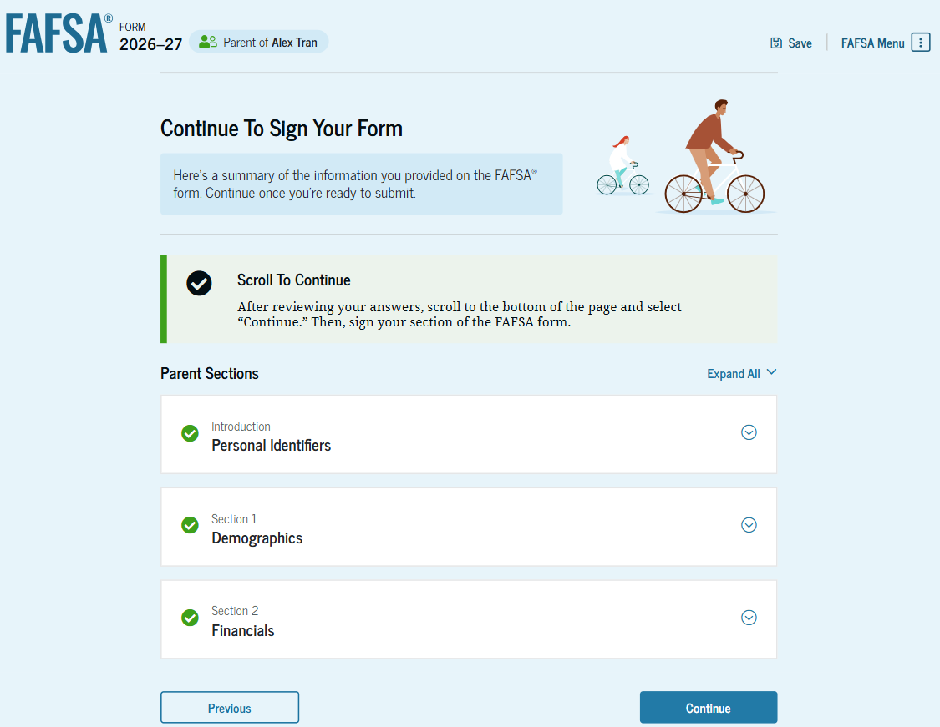
Dependent Student: Parent Review Page
If editing is needed, the parent can select the question’s hyperlink to be taken to the corresponding page.

Slide 30
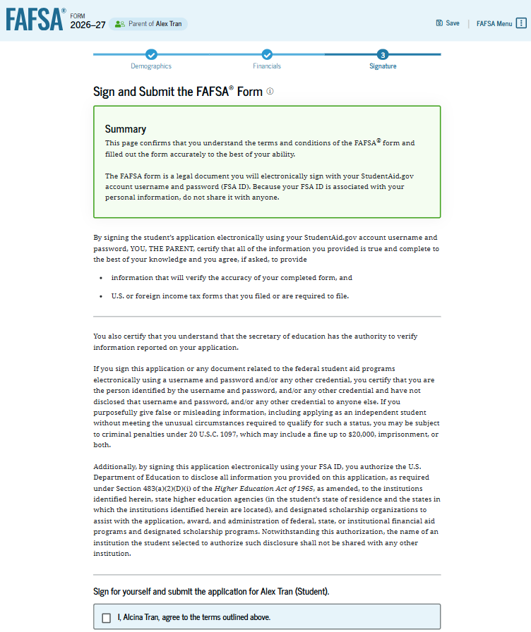
Dependent Student: Parent Signature
On this page, the parent acknowledges the terms and conditions of the FAFSA® form and digitally signs the parent section. Since all required sections are complete, the parent can both sign and submit the student’s FAFSA form.

Slide 31
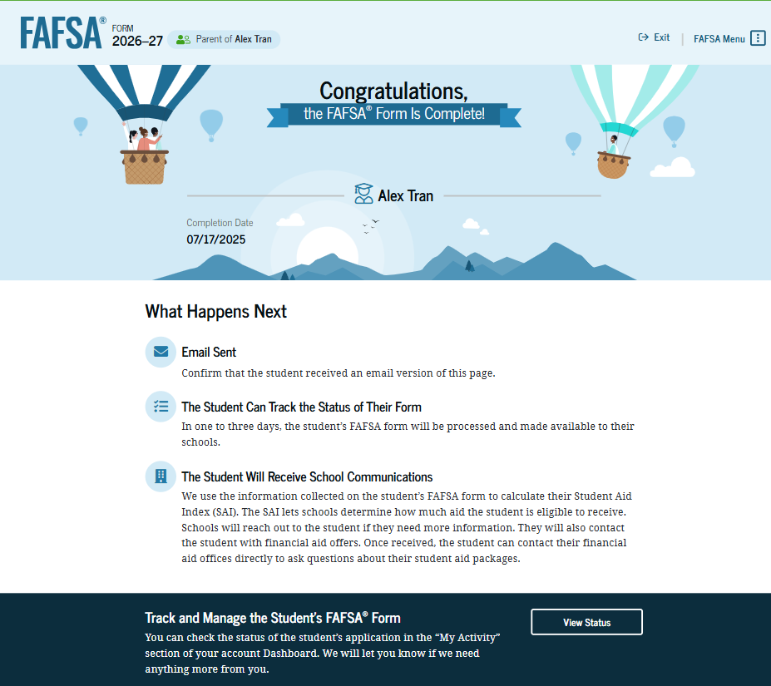
Dependent Student: Parent Confirmation
Upon submitting the student’s FAFSA® form, the parent is presented an abbreviated confirmation page. This page displays information about tracking the student’s FAFSA form and next steps. The student will receive an email with the full, detailed confirmation. With the student and parent sections completed and signed, the FAFSA form is now considered complete and submitted for processing.

Slide 32
Congrats!
Check your SAI (Confirmation page).
Review your FAFSA Submission Summary.
Make any corrections (if needed).
Compare schools and out-of-pocket costs.
Apply for scholarships!!!!!!

Slide 33
Seniors can now apply for OKP!
Get this done now if you qualify!!
Deadline: no later than December 31st of the senior year.
Income limit at the time of application:
$60K with 1-2 dependent children;
$70K with 3-4 dependent children;
$80K with 5 or more dependent children.
Once the student starts college or career education a 2nd income limit check will be required (FAFSA).

Slide 34
Other GEAR UP services for seniors
Free College Applications
Senior presentations (Intro to College Processes and Resources)
College trips focused on careers and majors
Concurrent enrollment fee Waiver
FAFSA Nights
Connect U: priority enrollment day for GEAR UP students at partner universities
College Orientation/Bridge/Rookie Camp reimbursement (Camp Cowboy, Camp Crimson, New Broncho Orientation, HillCamp, etc.)

Slide 35
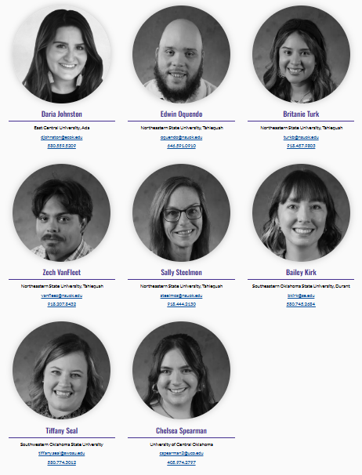
Beyond Graduation
College Freshmen benefit from College Success Coaches
GEAR UP Success College Coaches can be found at college campuses around the state and at GEAR UP high schools.
Their mission is to help all GEAR UP students transition to college. They also help college freshmen and families with questions, information, and the how-to on getting started at college.

Slide 36
Need Help?
Contact your GEAR UP Site Director

