Slide 1


Exploring Your Future: College & Careers
“Dream big. Plan smart. Start now.”

Slide 2
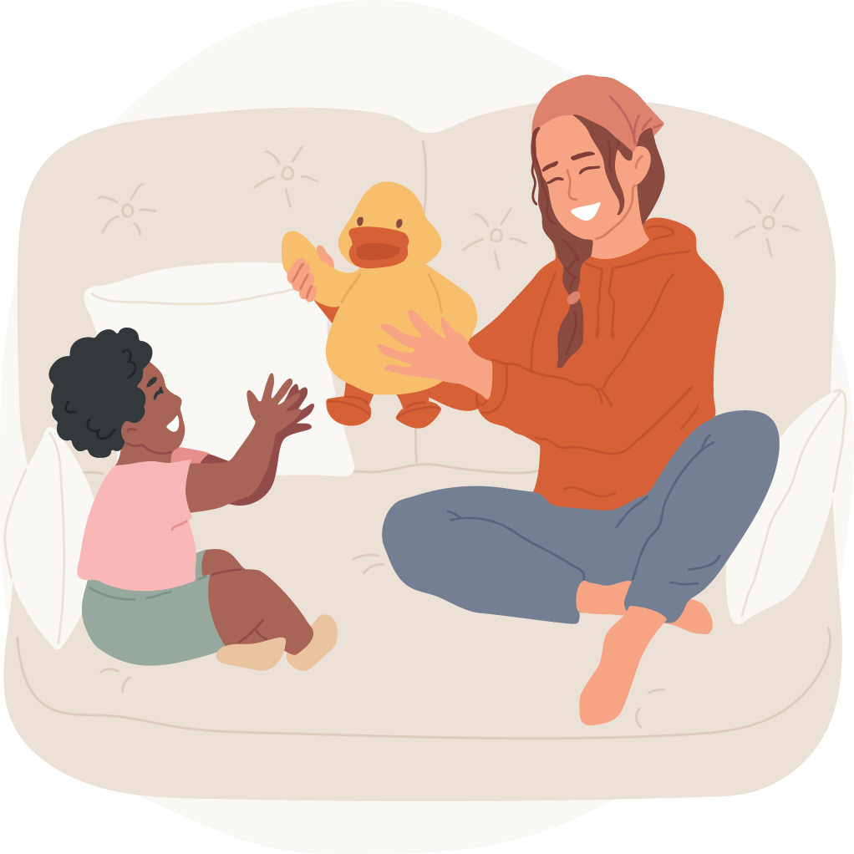

What’s the Difference Between a Job and a Career?
JOB
something you do to earn money.
Examples:
Babysitting, mowing lawns, working at a store
CAREER
a journey — a long-term path built on your skills, education, and interests.
Examples:
Teacher, nurse, engineer

Slide 3
What’s the Difference in the Hourly Wage Between a Job and a Career?
JOBS AVAILABLE TO THOSE WITHOUT DEGREES | HOURLY WAGE
Electrician’s Apprentice | $20.99
Nurse’s Aid | $15.86
Teacher’s Aid | $15.50
Fast Food Cook | $12.12
Vet Assistant | $15.91
Security Guard | $16.73
Manufacturing Technician | $18.91
Mental Health Specialist | $22.81
CAREERS THAT REQUIRE A DEGREE OR CERTIFICATION | HOURLY WAGE
Electrician | $32.27
Registered Nurse | $44.37
Teacher | $24.00
Chef/Head Cook | $23.55
Veterinarian | $73.93
Detective | $30.44
Civil Engineer | $48.87
Psychologist | $48.95

Slide 4
College Degree Benefits and Opportunities
$2.85 MILLION EARNED
  Bachelor’s degree-holders can expect to earn an average of $2.85 million in their lifetime.
  A worker with a high school diploma and no college degree can expect to earn an average of $1.6 million in their lifetime.
MORE OPPORTUNITIES
  Going to college presents you with more opportunities for employment down the road.
SCHOLARSHIPS AND GRANTS
  Attending college doesn’t have to break the bank. Grants and scholarships, like Oklahoma’s Promise, offer opportunities for you to earn money toward your education.
CHOOSE Your Career
  College opens the door to careers that fit your skills and what you love to do.

Slide 5



Tools for Career Prep
There are 3 big tools to help you discover your future:
Aptitude
Interests
Academics

Slide 6


Aptitude
Aptitude = natural talent or skill
  Examples: solving puzzles, fixing things, helping people, creativity
YouScience
  A tool that will help you discover your aptitude and help match you with your career path!
What You’re Good At
Ask yourself:
“What do I do well?”

Slide 7
Interests
“Interests” = things that make you excited or curious
When your interests match your work, you enjoy your career more!
  Examples:
    Love animals? → Vet, biologist
    Love technology? → Programmer, game designer
What You Enjoy
ACT Interest Inventory
  Will help you discover college majors or careers that are a good fit for you

Slide 8
Academics
Doing well in school builds the foundation for your future career.
Subjects like math, science, reading, and communication all matter.
College and career success starts with good study habits now!
What You Learn

Slide 9
Why Plan for College Early?
The earlier you start planning, the more options you’ll have.
You can take classes that match your goals.
Early planning = less stress later.
GEAR UP is here to help!

Slide 10
What is GEAR UP…
GEAR UP Services:
7th-12th Grade
  One-on-One Mentoring
    We are in your school everyday to help you plan for the future!
7th Grade:
  7TH Grade - College Visits
  Career Fairs
8th-12th Grade
  Oklahoma’s Promise & FAFSA Completion Assistance
    We will help you figure out how to pay for college!
8th & 11th Grade
  PreACT/ACT Testing
12th Grade
  College Application Assistance
  Concurrent Enrollment Support
…is a great resource for preparing you for college... at no cost to you!

Slide 11
College Visits – Why They Matter
• Help you see what college life is like
• Ask questions about majors, dorms, sports, and scholarships
• Make your goals feel real

Slide 12
Career Fairs – Why They’re Important
Meet professionals and ask about their jobs
Learn what skills and education they needed
Discover new careers you didn’t know about!
Learn about jobs in your community

Slide 13

Your Future Starts Now!
Explore your interests
Work hard in school
Ask questions and dream big!

Slide 14
GEAR UP IS HERE TO HELP YOU ON YOUR JOURNEY
INSERT YOUR CONTACT INFORMATION

